Slide 1
DataONE: From DataNet Project to Engaged Global Community in the Contemporary Data Landscape
Project Briefing
CNI Fall Membership Meeting
December 11, 2018
Notes:
Bob: Welcome and thank you for attending….

Slide 2
Panelists
William Michener, University of New Mexico, PI DataONE
Karl Benedict, University of New Mexico, co-chair DataONE Users Group
Nancy Maron, BlueSky to BluePrint
Robert J. Sandusky, University of Illinois at Chicago, co-chair DataONE Users Group
Notes:
Our panelists are

Slide 3

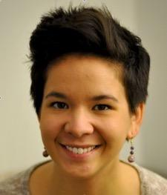
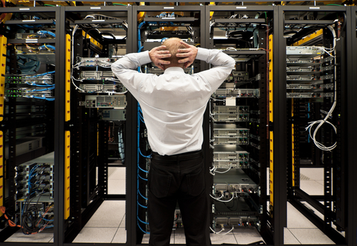







Briefing Goal
Engage Key Stakeholders in the New Landscape
Libraries
Researchers
Repositories
Funders
Notes:
The goal of today’s project briefing is to engage with you as members of one of DataONE’s key stakeholder groups: Library Deans and Directors.
DataONE began as a project about 9 years ago and the objectives set out for the project have been achieved. During those nine years the entire research data landscape has transformed. Commercial research data services – including Google Data Search – have emerged. There are now hundreds of data librarians in our college and research libraries.
Now it’s time for conversations about the way forward. We’ve planned to leave a good portion of our time together to have conversations about DataONE and its stakeholders in the contemporary data landscape.

Slide 4
Overview
DataONE as Project
DataONE Components & Impacts
DataONE as Community
Conversation – What do you need in the contemporary landscape?
Notes:
Many of you may have seen presentations about DataONE’s design and features in the past. We’re going to cover just a few things today to provide context for the discussion later.
Bob will very briefly recap the impetus and trajectory of the project during the cooperative agreement phase. (Bob?)
Bill will reviewDataONE impact (Bill?) - brief review of the major accomplishments of the cooperative agreement phase (data, repositories, tools, education, impacts, etc.)
Sustainability challenges (Nancy?) - what does it mean for any project to sustain? What are DataONE’s particular challenges?
DataONE as community (Karl?) - describing the transition from mostly project to mostly community-driven, owned, and operated
Conversation: community wants and needs (Nancy facilitates?)

Slide 5

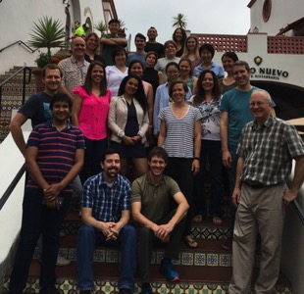
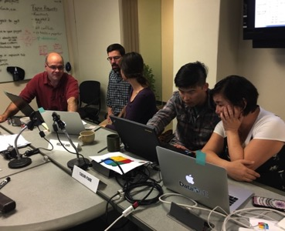
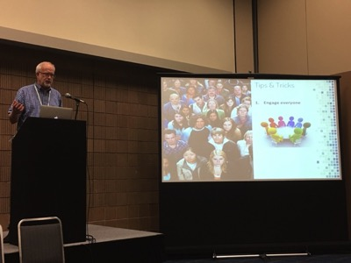
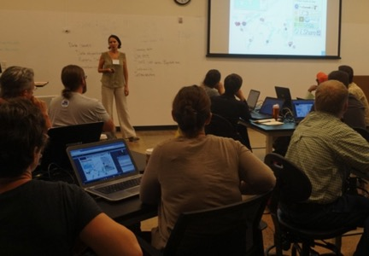

DataONE as Project
2007 – NSF DataNet Solicitation
Notes:
Many of the principle folks involved in developing the DataONE proposal had been working on data management issues for quite a long time, back to the late 1980s, mostly in the ecological and environmental sciences. They had a track record of successful collaborations prior to NSF’s release of the DataNet solicitation in 2007.
The solicitation recognized the value of Archival and Library and Information Science expertise, and integration of that expertise was required in proposals. The DataONE included investigators from the California Digital Library and the iSchool at the University of Tennessee as well as other subject matter experts outside of the ecoinformatics community, including folks from publishing, citizen science, and computer science.

Slide 6
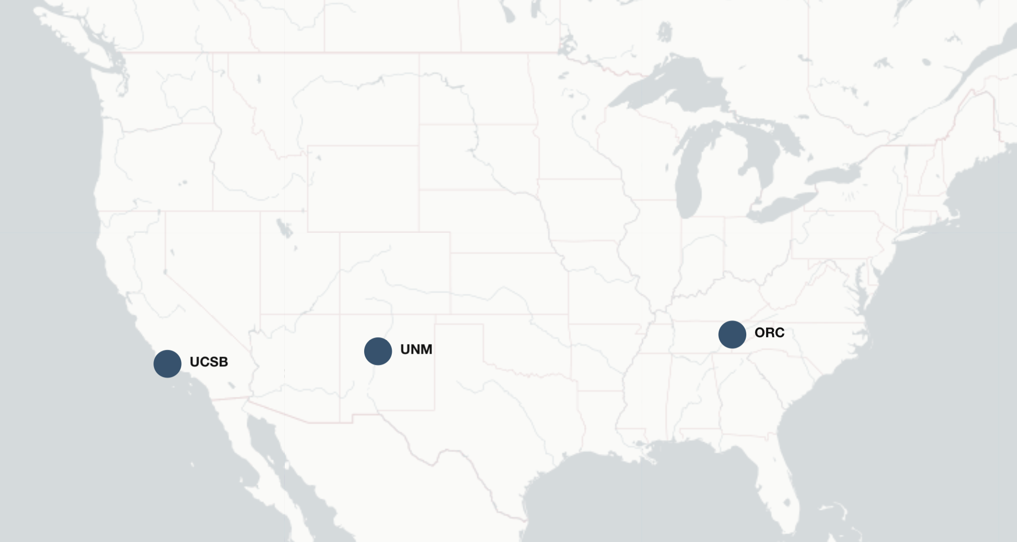





DataONE as Project
2009 – DataONE / NSF Cooperative Agreement
Metadata search catalog
Citation and usage
Reproducibility and provenance
Preservation
Metadata quality services
Culture of data sharing
Sociotechnical orientation
Coordinating Nodes
www.dataone.org/coordinating-nodes
Notes:
NSF made one of two five-year awards in that first round to DataONE in 2009. The cooperative agreement covered a range of activities and specific deliverables including creating production-quality cyberinfrastructure at scale.
DataONE built core services and APIs to provide
Central metadata index
Authentication
Integration of existing data repositories into the federation via APIs
Federated access and discovery
Dataset preservation across the federated repositories
Integration with researcher tools like Matlab and R
Data repository and dataset metrics
DataONE was conceived recognizing that related social, cultural, and educational transformation was as - or even more critical - to the eventual acceptance by domain scientists, universities, and publishers of research data as a first class product of the research enterprise deserving of powerful discovery tools, mindful curation, and preservation as a part of the world’s cultural heritage.
Key social and cultural issues included:
Supporting the emerging field of data librarianship and data curation
Training domain scientists about RDM, metadata standards, and tools
Supporting new standards and tool development: DataCite, DMPTool, Data citation best practices are some well-known examples

Slide 7
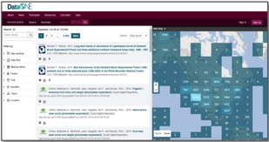


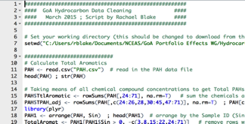




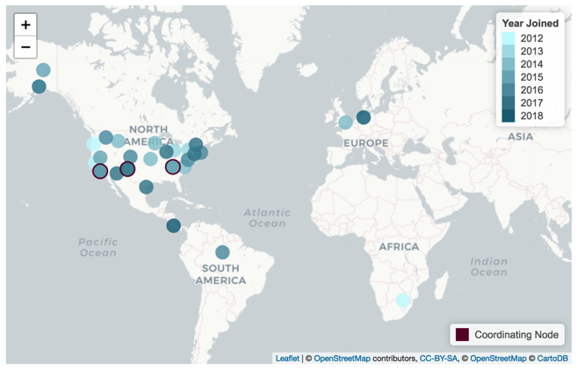

































Federated Earth Science Repositories
Core Cyberinfrastructure
CN
CN
CN

Slide 8
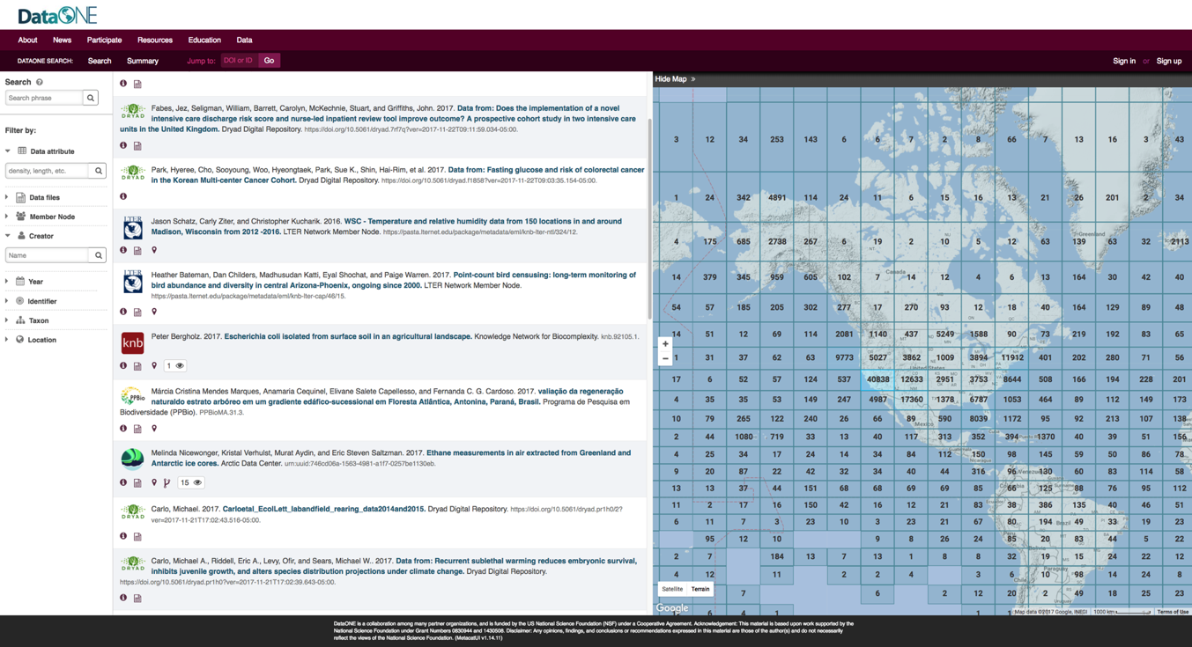
Federated Search

Slide 9
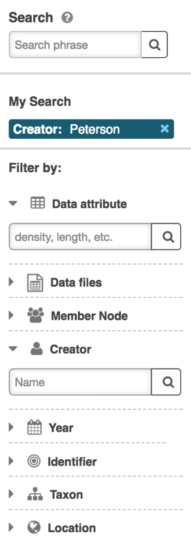
Federated Search

Slide 10
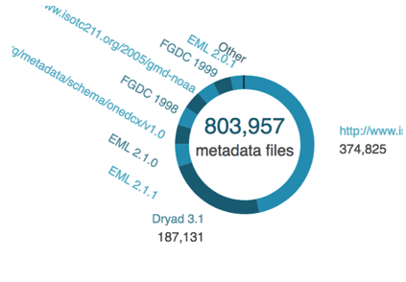
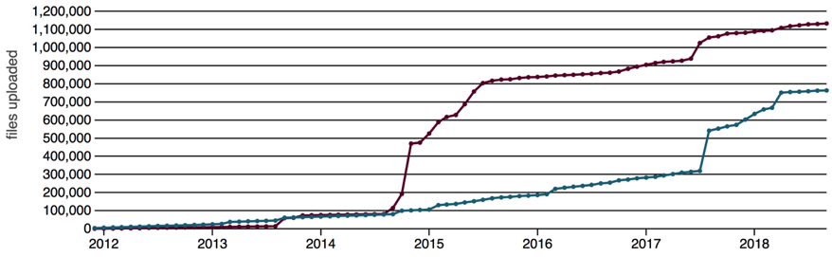
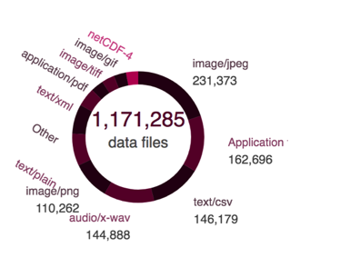
Current State of DataONE
50000
5000
500
50
0
Notes:
Amount of content
Number of member node
Activity and new features
Make data count
Quality assessment
Editor

Slide 11
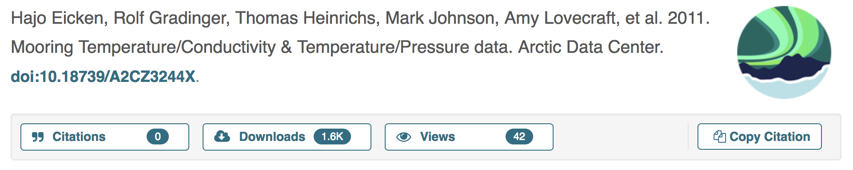
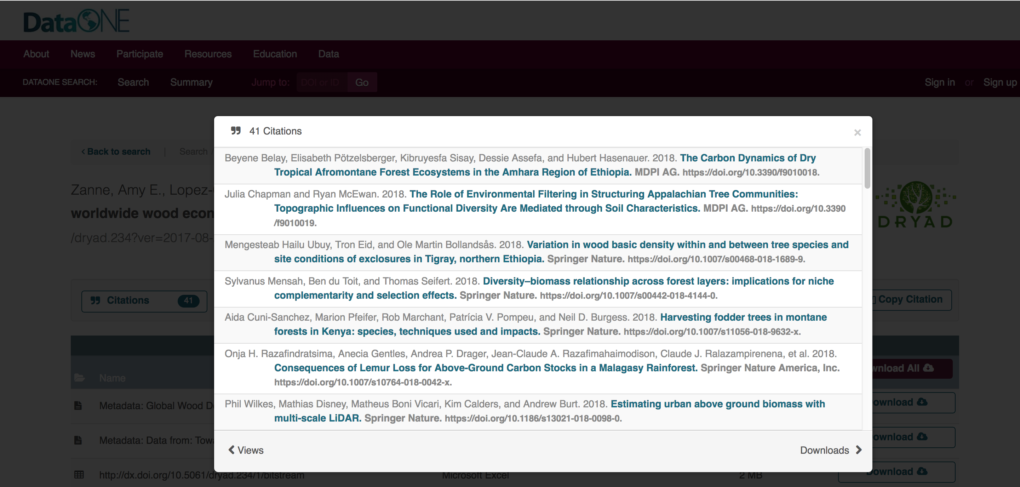
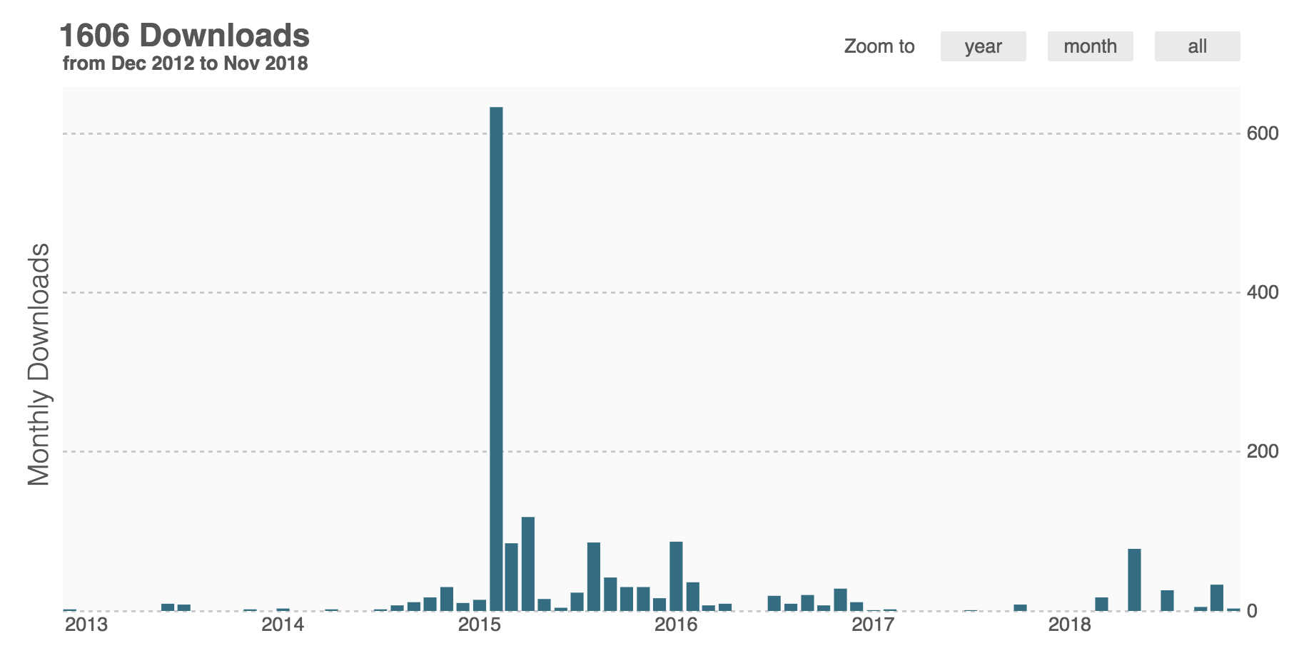

Data Usage and Citation

Slide 12
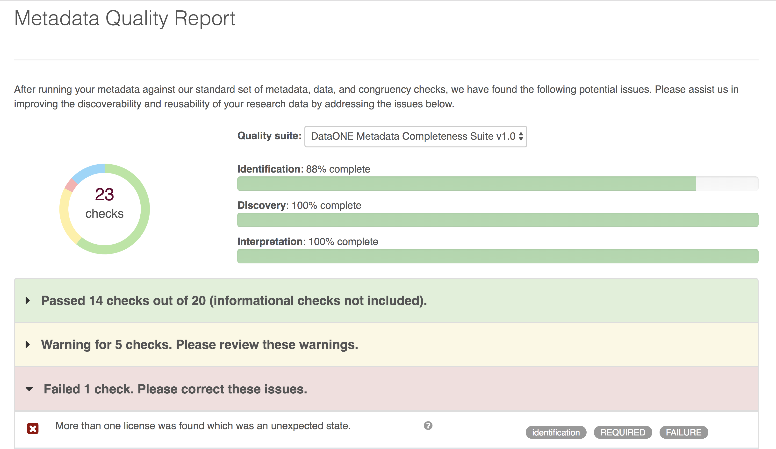
Metadata Quality Improvement

Slide 13
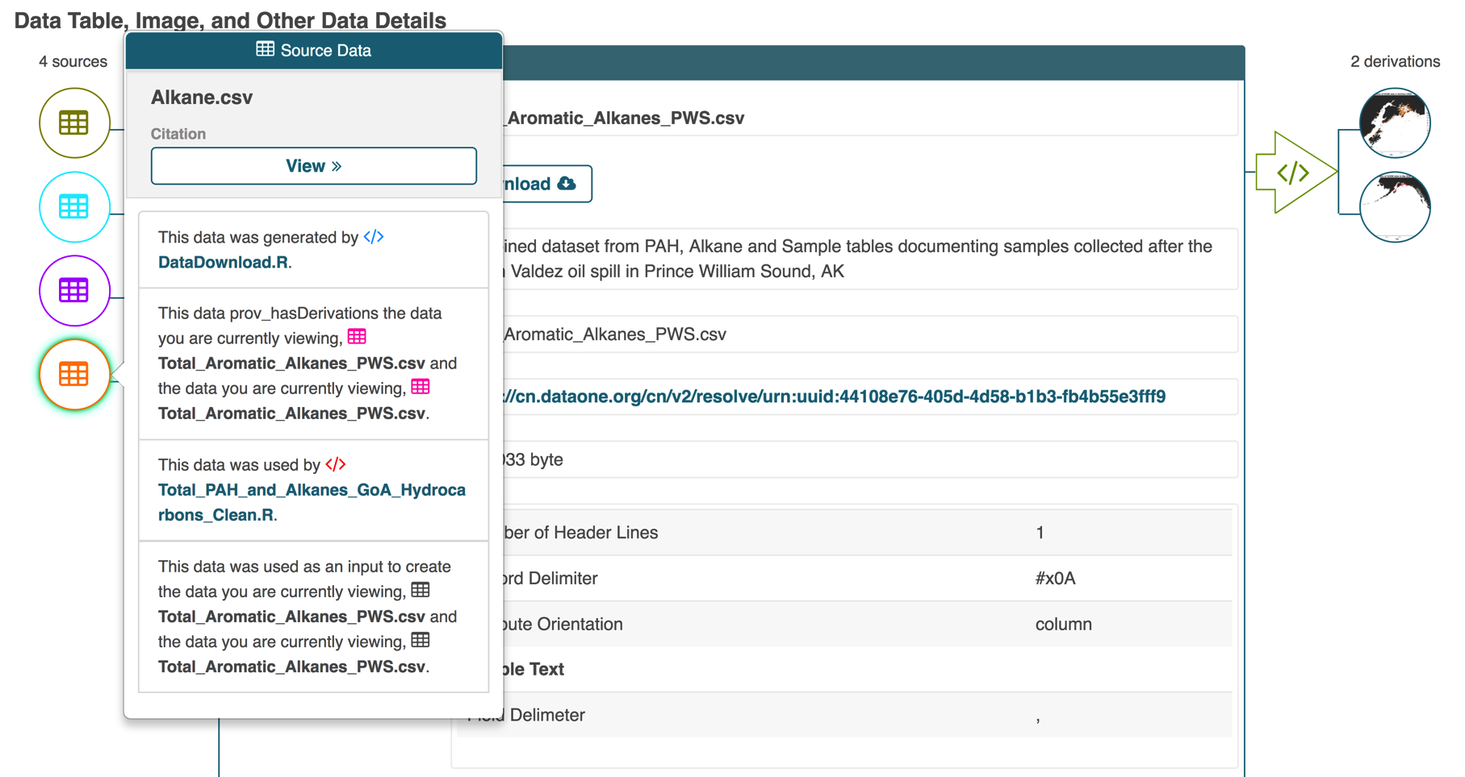
Reproducibility and Provenance

Slide 14
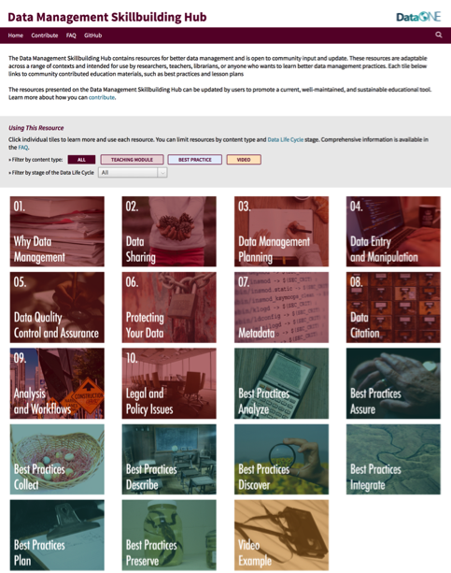
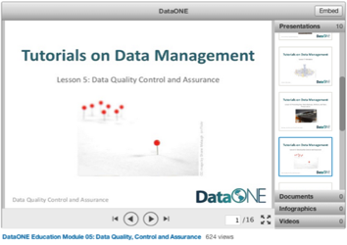
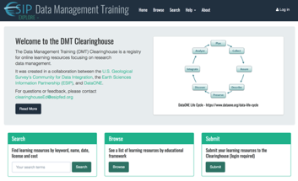
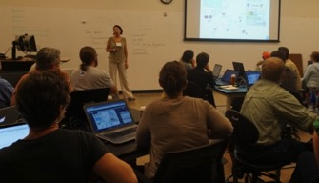
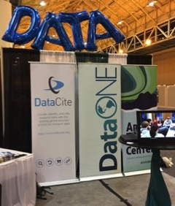


Education
15
34
Webinars
11
11
10
5
5
5
4
Plan
Collect
Describe
Assure
Preserve
Discover
Integrate
Analyze

Slide 15
Sustainability Wedges
A Strategic Path to Sustainability


Services
Grants
Sponsors
Partners

Slide 16
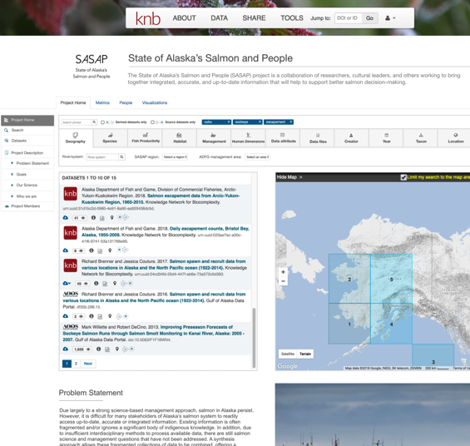
Repository Portal Services
Repositories, Institutions, Labs, Researchers
Target Community:
Benefits and Features:
Repository portal
Branded logo and repository description
Aggregated citation and usage
Aggregated quality reports
Customized search filters
Hosted repository service
Researchers
Researchers
Funders
Repositories
Libraries
Repositories
Libraries
Notes:
For the target community – delete appropriate stakeholder group(s) and delete the upper button to reveal the transparent button below it.

Slide 17

Repository Preservation Services
Target Community:
Benefits and Features:
DOI minting service
Data replication to DataONE
Replication auditing service
Researchers
Funders
Repositories
Libraries
Repositories
Libraries
Notes:
For the target community – delete appropriate stakeholder group(s) and delete the upper button to reveal the transparent button below it.

Slide 18
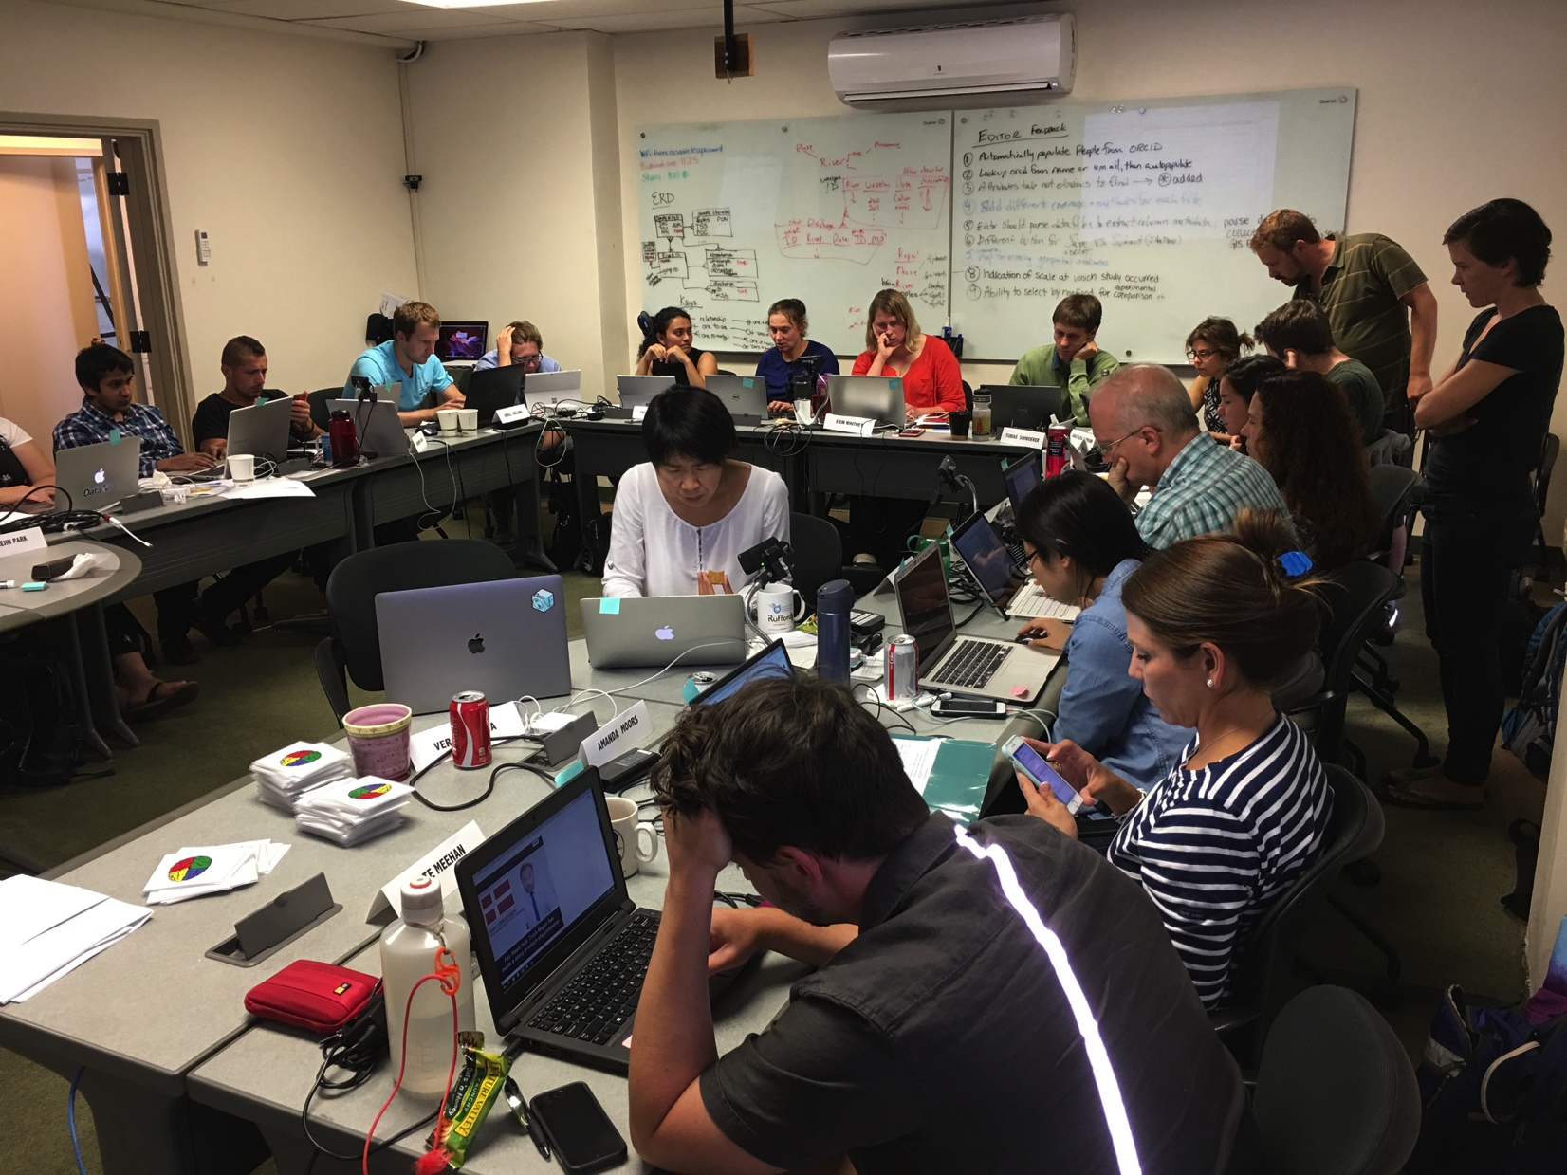
Data Science Training
Target Community:
Benefits and Features:
Train the trainers
Train researchers
Open science
Data management
Reproducible workflows
Researchers
Funders
Repositories
Libraries
Researchers
Libraries
Notes:
For the target community – delete appropriate stakeholder group(s) and delete the upper button to reveal the transparent button below it.

Slide 19
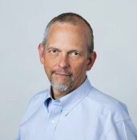
Community
501
432
Informing the development, prioritization and direction of DataONE
392
310
Karl Benedict
210
152
Bringing together community to address challenges and explore shared solutions
97
60
32
Robert Sandusky
2010
2011
2012
2013
2014
2015
2016
2017
2018

Slide 20






Where we are …
Community/
Collaborators
MN
MN
MN
MN
MN
MN
MN
MN
MN
MN
MN
MN
MN
MN
MN
MN
MN
Coordinating
Nodes
Replication
Nodes
MN
MN
MN
MN
MN
MN
MN
MN
MN
MN
MN
MN
MN
MN
MN
MN
MN
MN
MN
MN
MN
MN
MN
MN
MN
MN
MN
MN
Notes:
… and over 40 member nodes that have been developed and are maintained by collaborating data repositories, either using the DataONE generic member node platform, or other software systems that support integration with DataONE’s metadata harvesting, indexing, search, and (optionally) replication capabilities.
[click]

Slide 21
Where we’re headed …
Training & Tools
Researchers
Libraries – Data Librarians
Software Developers
Institutions
Funders
Publishers
Replication
Nodes
Community/
Collaborators
Coordinating
Nodes
Infrastructure
Disciplinary Repositories
Institutional Repositories
Commercial Repositories
Large-scale Data Producers
Funders
Publishers
Computing Service Providers
MN
MN
MN
MN
MN
MN
MN
MN
MN
MN
MN
MN
MN
MN
MN
MN
MN
MN
MN
MN
MN
MN
MN
MN
MN
MN
MN
MN
MN
MN
MN
MN
MN
MN
MN
MN
MN
MN
MN
Notes:
All of these products and services comprise the research data management, documentation, discovery, access, use, and preservation ecosystem that DataONE has built over the past 9+ years of the project. As DataONE is now in its final year of the second phase of funding from NSF, the project team is working to
Transition from a project-centric model, to a community driven model in which the various stakeholders in the DataONE ecosystem have a significant role in the ongoing evolution of and support for the DataONE products. Building on the community engagement model already developed – including the DataONE Users Group.
[click]
… where different stakeholder groups are likely to play different roles in the emerging model for sustaining and growing the capabilities developed by DataONE
[click]
Infrastructure
Disciplinary Repositories
Institutional Repositories
Commercial Repositories
Large-scale Data Producers
Funders
Publishers
Computing Service Providers
[click]
Training & Tools
Researchers
Libraries – Data Librarians
Software Developers
Institutions
Funders
Publishers

Slide 22
Translation into a governance and operational model
Needs Assessment
Prioritization
Execution
Community Roles/Structures
Membership Organization
Advisory Board
Community Managed Development Projects
Collaborative Proposals
Funding Agencies
Administration
Coordination
Institutional Home (i.e. UCSB) or free-standing incorporated entity
MN
MN
MN
MN
Notes:
Actions needed:
Engage with stakeholders
individually through Nancy’s Interviews
As groups through CNI, AGU, DUG, and ESIP
Evolve model for emerging governance model
Develop structures for integrating community into these structures that maximizes capacity for community to contribute to and benefit from evolving network capabilities.
Establish community ”ownership” of resources to enable broader contributions and management of ongoing development.
Modifications
Shrink institutional bubble – fuzz community boundry
Remove DataONE from replication node circles
Generalize collections to de-emphasize numbers

Slide 23



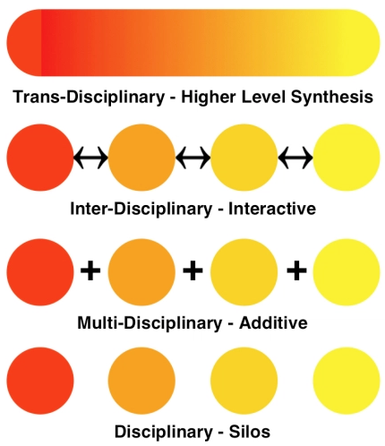
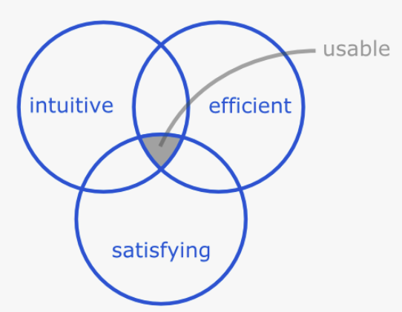

Conversation
Training
Sustainability
https://www.uts.edu.au/about/uts-business-school/our-research/
hub-sustainable-enterprise/anthropocene-transition-project
23

Slide 24
Conversation
Community Needs In the Contemporary Landscape
What research data support does the academy need?
Research data discovery?
Research data storage?
Research data preservation?
Data management education and outreach?
Researchers
Graduate / professional students
Undergraduates
Librarians
Staff
Notes:
Conversation and interactivity…. Modalities and engaging questions to be determined.
Some kind of live voting to ID topics of most interest to those present (from among discovery / storage / preservation / education & outreach / other)? A quick Qualtrics survey from attendee phones??
Or perhaps better to frame the discussion in terms of willingness to take some kind of collaborative / collective action?

Slide 25
Conversation
Community Needs In the Contemporary Landscape
What research data support does the academy need?
Research data discovery?
Research data storage?
Research data preservation?
Data management education and outreach?
Researchers
Graduate / professional students
Undergraduates
Librarians
Staff
Notes:
What are the opportunities for ‘DataONE as Community’ to help meet the community’s needs?
We likely have said some things about potential / ongoing DataONE products, so get input from audience on how DataONE can meet the needs they just told us about. Also try to get new ideas that resonate with the audience.
What are the areas of most promise from the POV of attendees?

Slide 26
Conversation
Community Needs In the Contemporary Landscape
How can voices from the academy lead DataONE?
Notes:
Who’s voices should be heard as part of “DataONE as Community”?
What structures and / or venues are best for hearing and amplifying those voices?
What is the appetite / capacity for participation in community leadership from those in the audience (mostly library deans/directors and associate deans/directors plus technologists)?

Slide 27
Tell Us More
We want to talk more with you!
One-on-one 30 minute conversations
Contact <info>.
Notes:
We’re interested in talking to representatives from around the world
Library leaders from a range of college and research libraries
Operators of research data repositories
Research office leaders
Funders

Slide 28
EXTRA slides not used

Slide 29
Increasing Data Literacy through Data Science Training
Data Science Training Institute and Train-the-Trainer Community Building
Target Community:
Impact:
Increase in reproducible science through a larger corpus of well-described, publicly-accessible, high quality data
Outcomes/Products:
Established data science training institute offering intensive tailored training to end users
Trainer-the-trainer programs providing support and education to two distinct communities
Domain faculty
Librarians
Researchers
Funders
Repositories
Libraries
Researchers
Librarians
Notes:
For the target community – delete appropriate stakeholder group(s) and delete the upper button to reveal the transparent button below it.

Slide 30
Data
Global Coverage
50000
5000
500
50
0

Slide 31
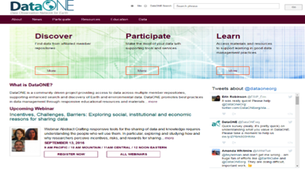
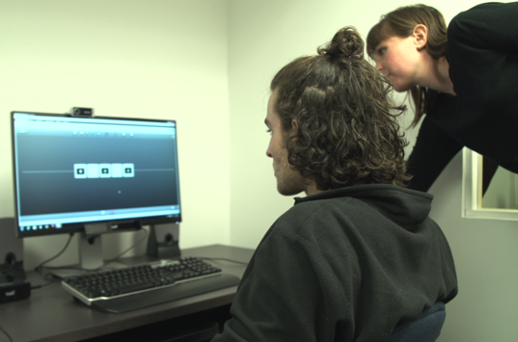
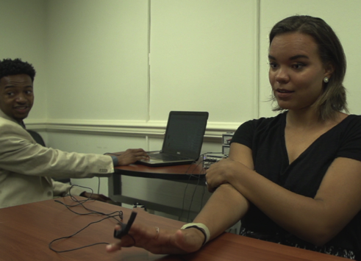
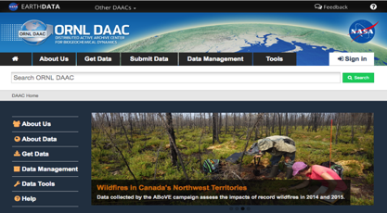
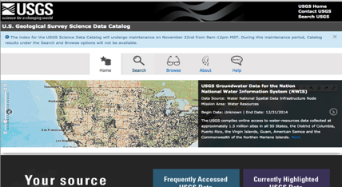
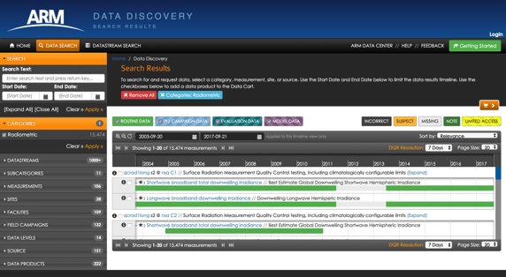
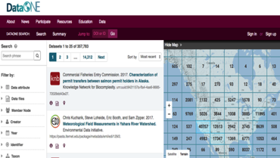
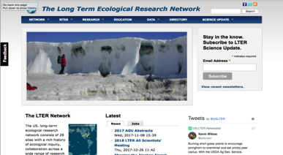
User Experience Evaluation

Slide 32
DataONE Sustainability Challenges
Assess landscape & stakeholders
Identify products & value
Determine costs
Develop funding
model

Slide 33









Metrics
Global Data Coverage
804K Data Packages
34 Webinars
10 Education Modules
42 Member Nodes
150K Contributors
19,600 Users/Month
5300+ Trained

Slide 34







































Building the Federation
2014 – DataONE / 2nd Five-Year Award
2012
2
3
4
2013
2
3
4
2014
2
3
4
2015
2
3
4
2016
2
3
4
2017
2
3
4
2018
2
3
4
Future Data Repositories
Notes:
DataONE received a second five-year award in 2014. In addition to the funding provided by the cooperative agreement, DataONE has collaborated with others on grants for related CI and CEO initiatives
Make Data Count
Whole Tale
Laura Bush 21st century librarians awards from IMLS
Bill Michener will take over to talk about the outcomes and impacts of DataONE on our stakeholder communities since 2009.

